Slide 1
Generative AI
Innovation, Applications, and Security Layers

Slide 2
What is GEN AI
Generative AI refers to a type of artificial intelligence that creates new, original content, such as images, video, audio, and text, using machine learning algorithms. It works by learning from existing data and producing new content based on that learning.
Core Technologies:
Neural Networks: These are a type of machine learning model that mimics the way the human brain processes information, making them ideal for complex tasks like image and text generation.
Transformers: Advanced models like GPT (Generative Pre-trained Transformer) are built using transformer architecture, which allows them to understand and generate language with a high degree of coherence and context.
Generative Adversarial Networks (GANs): These involve two neural networks—the generator and the discriminator—competing against each other to create highly realistic images, audio, or video.

Slide 3
Difference between Machine learning and GENAI
Generative AI and Machine Learning represent two pivotal, yet distinct, methodologies under the AI umbrella.
While Machine Learning focuses on learning from data to make predictions or decisions, Generative AI takes a step further into the realm of creativity, generating new content that mimics the original. Both have their unique applications and implications, driving innovation and reshaping our interaction with technology. As we continue to explore these territories, the synergies between Generative AI and Machine Learning will undoubtedly unveil new possibilities, pushing the boundaries of what machines can learn, create, and achieve.

Slide 4
Ethical and Security Considerations
Bias: Generative AI models can sometimes reproduce or even amplify biases present in the training data.
Misinformation: The ability of Generative AI to create realistic but fake content, like deepfakes, poses challenges for misinformation and trust.
Intellectual Property: Questions arise around who owns the content generated by AI, especially when it's based on existing data.

Slide 5
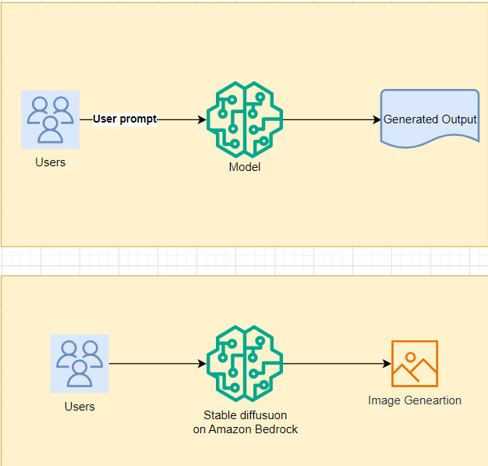
Text Generation Model
The basic text generation pattern is good for the following use cases:
General content creation, where factuality isn't critical
Basic question & answer for well-known facts that are repeated frequently on the internet
The image generation pattern is good for the following use cases:
Creation of custom imagery for websites, emails, etc.
Creation of concept art for various media forms

Slide 6
Inference Configurations
Temperature controls the randomness by scaling logits, where lower values produce safer, more predictable text, and higher values lead to more creative text.
Top-k sampling limits the model's choices to the top k words, controlling how many possible next words are considered.
Top-p sampling dynamically limits the choice based on cumulative probability, allowing for more flexible and context-aware sampling

